Slide 1
SMAI Project
A Deep Recurrent Neural Network with BiLSTM model for Sentiment Classification

Slide 2
Outline
AIM
Theory
Model Definition
Datasets
Experiments
Results
Individual Contribution

Slide 3
Aim
To develop a Sentiment classification model using Deep Recurrent Neural Network (RNN) with Bidirectional LSTM wrapper.

Slide 4
Why?
With the elevation in the communication technology, a huge number of people from all lineages across the world take part in social networks and express their opinions on a wide range of topics. Now it is a dire need to summarize the data created by people over the social networks and see the insights from them. Besides, in the field of NLP, it has become a topic of enormous interest. Because, it is needed to make smart recommending systems, anticipating the results of political elections, understanding the feedback of people on public events and movements.

Slide 5
Theory

Slide 6
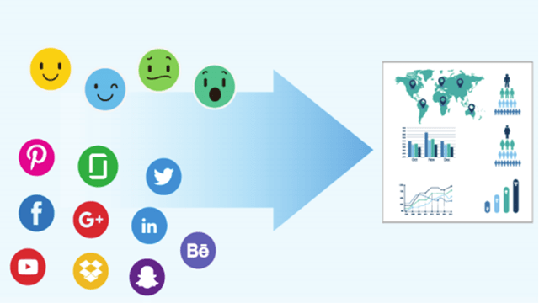

What is Sentiment Classification ?
Sentiment Classification/Analysis is a method of finding and classifying opinions expressed in a piece of text basing on computation technologies, especially in order to find out whether the writer’s behavior towards a specific topic, product, etc. is positive, negative, or neutral.
Sentiments are the reflection of the beliefs, choices and activities of the people.

Slide 7
Use cases of Sentiment Classification
Predicting the success of a movie based on Movie reviews
Result prediction in political elections
Smart recommendation systems - Ex: During ‘Ban Chinese Products’ movement in India, the people in favour of it could be recommended indigeneous products on online shopping platforms
Brand reputation
Understanding consumer needs
The Obama administration used opinion mining in the 2012 presidential election to detect the public opinion before the announcement of policy.

Slide 8
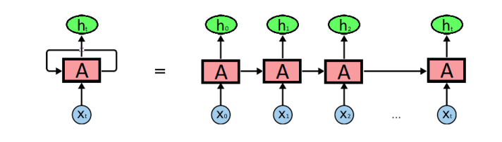
RNN
RNN or Recurrent Neural Network is a type of ANN in which we use the previous calculated data to get the new output.
RNN are a type of network which form memory through recurrent connections. In feed forward networks, inputs are independent of each other. But in RNN, all inputs are connected to each other. This lets the network to exhibit vigorous temporal behavior for a time sequence which makes it favorable for sequential classification like sentiment analysis.

Slide 9
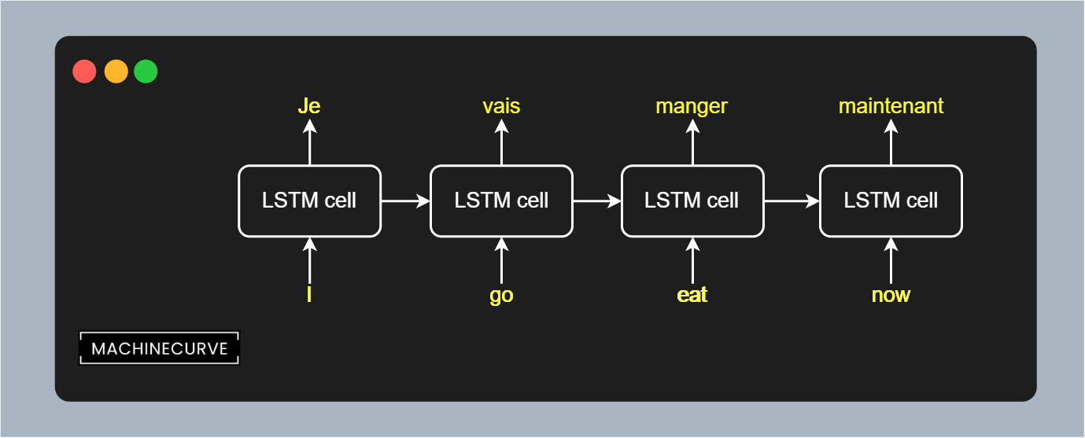
LSTM
LSTM stands for “Long short-term memory” is an artificial neural network architecture used in the field of deep learning . LSTM networks are well-suited for classifying , processing and making predictions based on time series data .

Slide 10
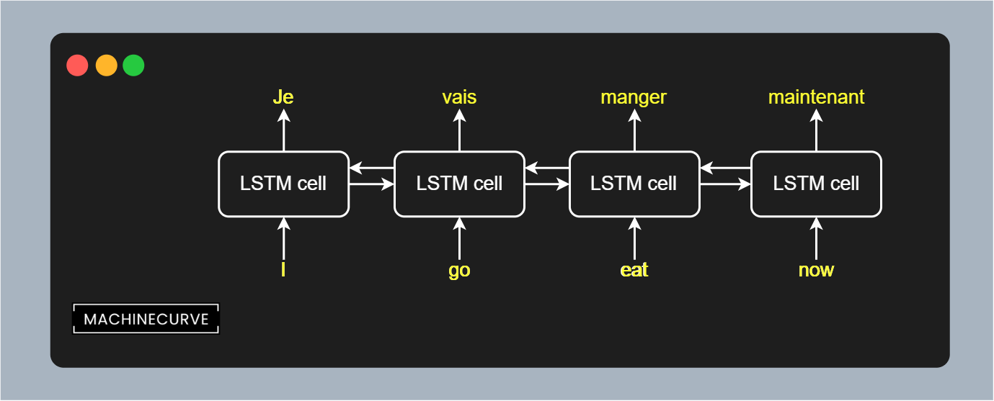
Bi-LSTM
In unidirectional LSTM information flows from the backward to forward. On the contrary in Bi-directional LSTM information not only flows backward to forward but also forward to backward using two hidden states. Hence Bi-LSTMs understand the context better.

Slide 11
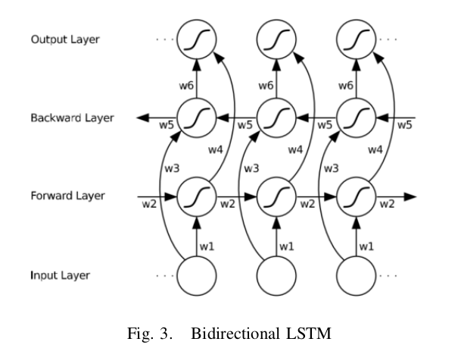
Bi-LSTM (cont..)
Using bidirectional will run your inputs in two ways, one from past to future and vice-versa and what differs this approach from unidirectional is that in the LSTM that runs backward you preserve information from the future and using the two hidden states combined you are able in any point in time to preserve information from both past and future. BiLSTMs show very good results as they can understand the context better.

Slide 12
Model Definition

Slide 13
Our BiLSTM model consists of the following layers:
Embedding Layer: It creates word vectors of each word in the word_index and groups words that are related or have similar meaning by analyzing other words around them.
Masking layer: Masking is done to allow the model differentiate between an actual sequence value and padded sequence value.
Bidirectional LSTM layer: To make a decision to keep or throw away data by considering the current input, previous output, and previous memory.
Dense Layer: Fully connected neural network layer with sigmoid activation.
The optimizer used is Adam optimizer and the loss function is Binary Cross Entropy.

Slide 14
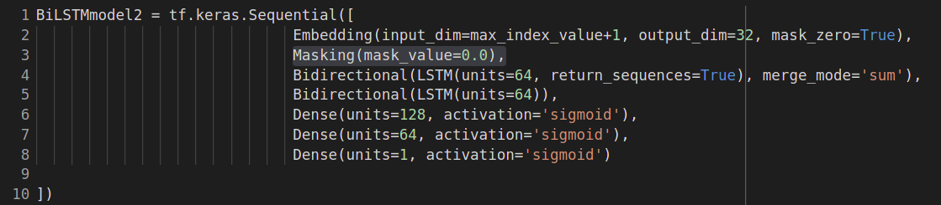
Defining the model using Keras API

Slide 15
Dataset

Slide 16
Dataset Description
IMDB movie review dataset
49,582 movie reviews in English
Each movie review labelled as positive or negative

Slide 17
Experiments

Slide 18
We experimented with three different model types within feedback models;
Simple RNN
LSTM
Bi-LSTM
For each model type, we defined a couple of models by adding or removing some layer(s).

Slide 19
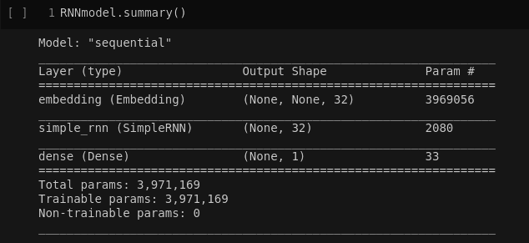
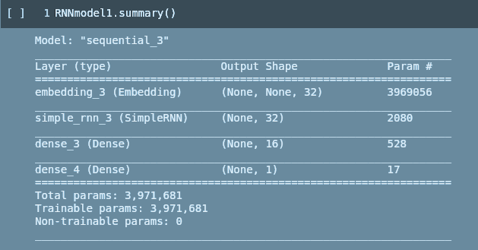
Simple RNN models

Slide 20
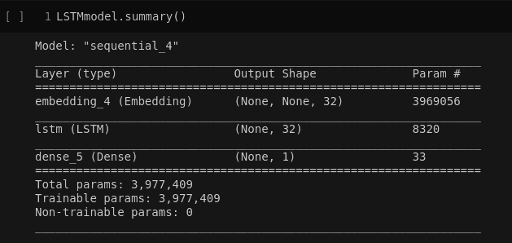
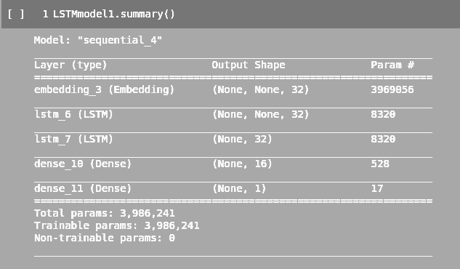
LSTM models

Slide 21
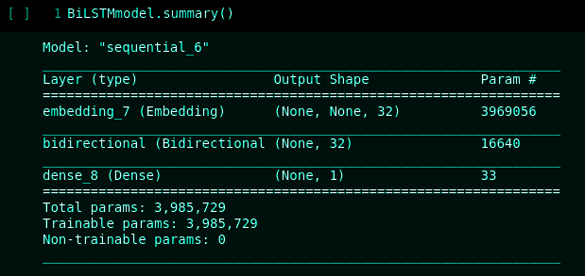
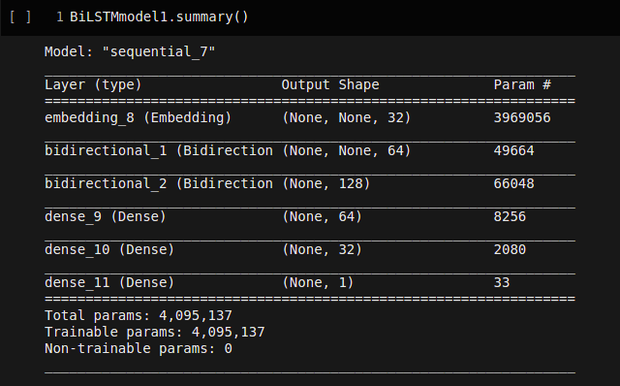
Bi-LSTM models

Slide 22
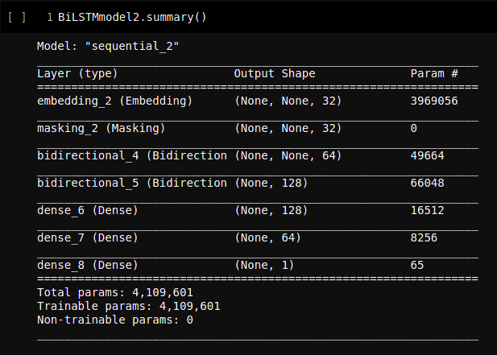

Slide 23
Results

Slide 24
Result/Analysis
Model | Test-set Accuracy(%)
Simple RNN | 83.48
LSTM | 85.95
Bi-LSTM | 88.31
Using Bi-LSTM model, we were able to achieve test set accuracy of 88.3%(Highest amongst all feedback models)

Slide 25
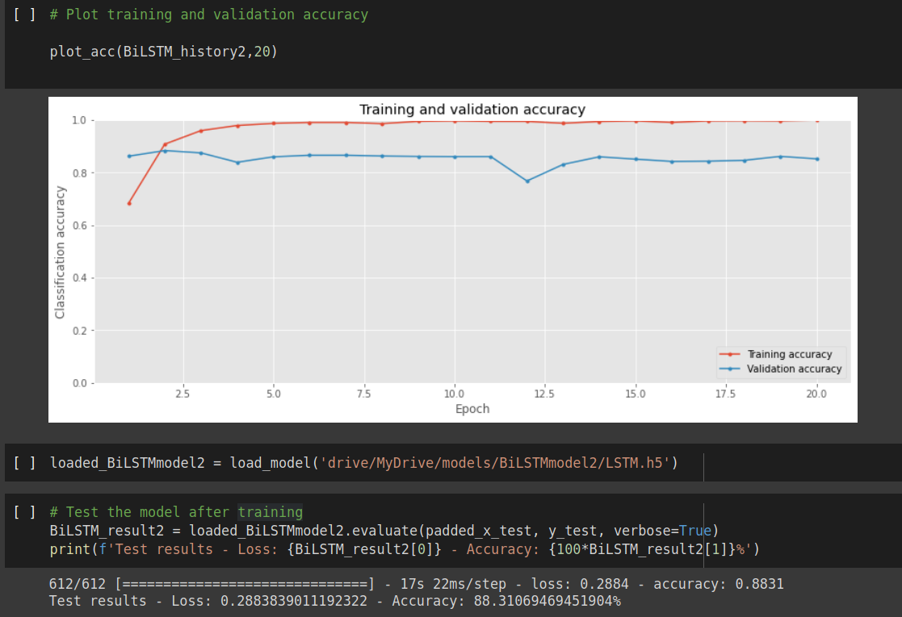
Accuracy
Model consists of:
1 Embedding Layer
1 Masking Layer
2 Bi-LSTM + RNN Layers
3 Dense Layers

Slide 26
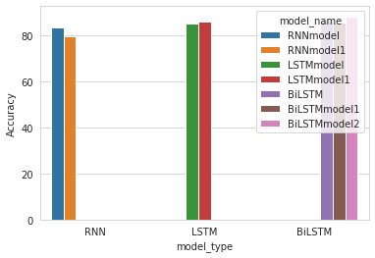
Barplot showing accuracies for different models
( 1 Embedding Layer added with all models)
RNN:-
  RNNmodel: 1 Simple RNN + 1 Dense
  RNNmodel1: 1 Simple RNN + 2 Dense
LSTM:-
  LSTMmodel: 1 LSTM + 1 Dense Layers
  LSTMmodel1: 2 LSTM + 2 Dense Layers
BiLSTM:-
  BiLSTM: 1 Masking + 1 BiLSTM + 1 Dense Layers
  BiLSTMmodel1: 2 BiLSTM + 3 Dense
  BiLSTMmodel2: 1 Masking + 2 BiLSTM + 3 Dense Layers

Slide 27
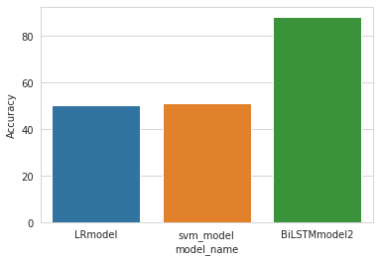
Comparison with other models
Models used for comparison:
Logistic Regression (LR) Model
SVM Model
Bi-LSTM
Conclusion
BiLSTM model proves to be the best classifier for sentiment classification on this data

Slide 28
Thank you.

